Slide 1
Water Potability Prediction
With Machine Learning
Team members:
Abhishek kumar
Aniket Dubey
Lavanya Gupta
Harsh Bharadwaj

Slide 2

Agenda:
The importance of potable (safe or drinkable)water cannot be overstated, as it is fundamental to human health, development and quality of life.
There are some key reasons why potable water is critical:
1) Health & Disease Prevention
2) Support Nutrition & Food Safety
3) Economic & Social Development
4) Environment & Sustainability benefits
5) Human Rights & Equity

Slide 3
Water potability prediction involves assessing whether water is safe for human consumption by analyzing various physicochemical properties. This can be a supervised machine learning problem, where we classify water samples as potable or non-potable based on certain indicators.
Here's a typical approach to build a predictive model.
Data Collection: Gather a dataset with water quality parameters and labels indicating whether the water is potable. Common datasets include physicochemical properties such as:
Ph
Hardness
Solids(dissolved solids)
Chloramines
Sulfate
Conductivity-Organic Carbon
Trihalomethanes
Turbidity

Slide 4
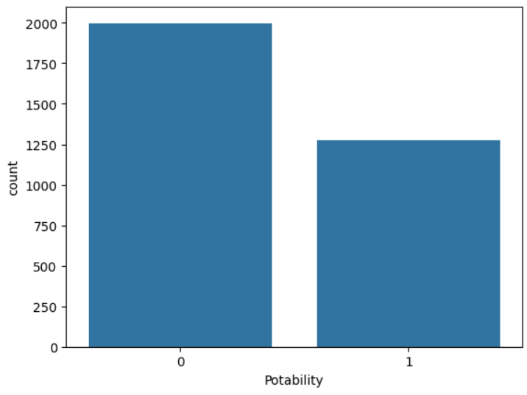
Technology Used:
Potability Values in the term of Binary (0-1)
Pandas is used for data manipulation and analysis, making it easy to handle and clean datasets.
NumPy supports numerical computing by providing arrays and mathematical functions for efficient calculations.
Seaborn is used to create attractive and meaningful statistical graphics for data analysis.
Matplotlib helps in generating static, interactive, and animated visualizations.
Pydotplus is used for interactive and web-friendly charts with scikit-learn library.
Scikit-learn (Sklearn) is used for machine learning tasks such as classification, regression, and clustering.
Smote is used to address the problem of imbalance datasets

Slide 5
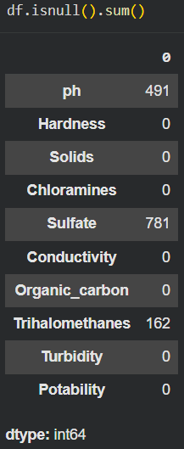
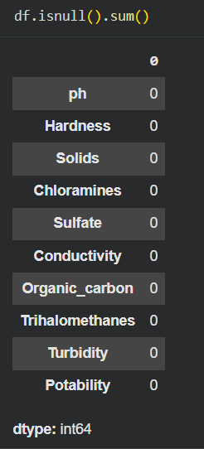
Exploratory Data Analysis
Examine the data for any missing values, outliers and basic statistics. Missing values are common in such datasets and might need to be filled using mean, median or other imputation techniques.
Feature Engineering: Certain features may benefit from transformations to normalize or standardize the data, which is often helpful for models sensitive to feature scales (support vector machines)

Slide 6
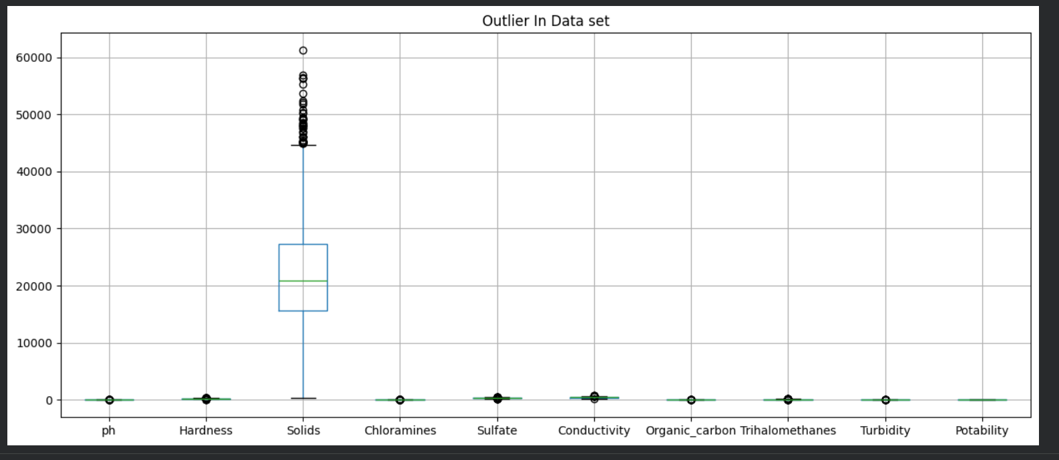
CHECKING FOR THE OUTLIERS SO THAT THEY CAN BE REMOVED FOR MODEL BETTER PERFORMANCE

Slide 7
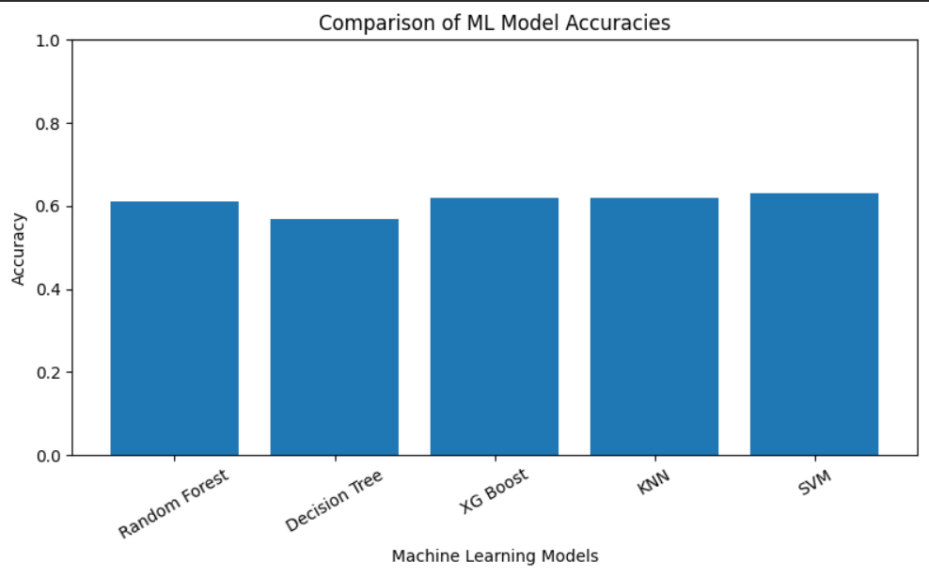
Model Selection:
Select an appropriate model to predict potability. Commonly used models for classifications include:
Decision Tree
Random Forest
KNN-K-Neighbor
SVM
XG-Boost

Slide 8
This is how I created my ml models with highest accuracy on Svm classifier
Data Analysis:
We explored relationships between features and potability, revealing trends in water quality metrics that contribute to water safety. This helped us understand the influence of various chemical and physical properties on potability.
Model Performance:
By training different machine learning models, we identified the best-performing model based on metrics like accuracy and precision. Ensemble methods, such as Random Forests, often performed well due to their ability to handle feature interactions and variances.
Challenges:
Missing values and varying distributions across features presented challenges. Data preprocessing steps like handling missing values and scaling helped improve model accuracy and stability.
Impact of Feature Engineering:
Scaling and normalization improved model performance, and hyperparameter tuning helped optimize the selected model. These steps were essential in achieving better predictive accuracy and reliability

Slide 9
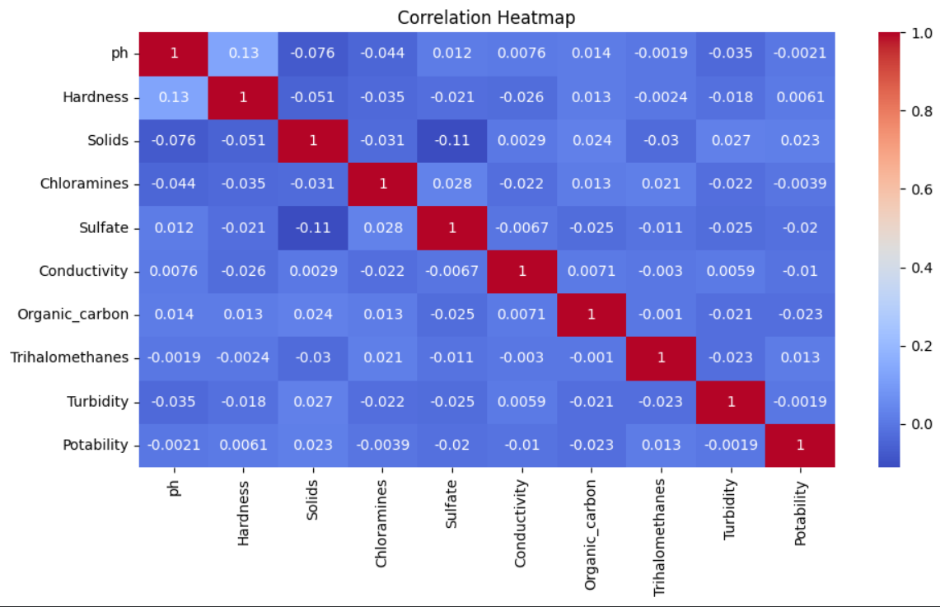
CREATION OF HEAT MAP TO SHOW DIRECT RELATIONS
Creating a heatmap is a great way to visualize correlations or patterns in a dataset, especially for water potability data where you want to see relationships between variables (like pH, hardness, etc.) and potability. In Python, you can use libraries such as Matplotlib and Seaborn to create heatmaps.

Slide 10
Conclusion of the water Potability Prediction Project
In this project, we built a machine learning model to predict the potability of water based on various water quality features such as plt, hardness, solids, chloramines, sulfate, conductivity, organic carbon, trihalomethanes, and turbidity, By analyzing and processing this data, we trained and evaluated several models, identifying the best one for predicting whether water samples safe to drink.
Conclusion
Our final model effectively predicts water potability based on the provided quality metrics, demonstrating that machine learning can be a valuable tool for water quality assessment. Such a model can assist in real-time water monitoring, aiding authorities and communities in ensuring safe drinking water, However, model accuracy and reliability may be further improved with more data, especially if it includes additional environmental and seasonal factors.

Slide 11
Thank You!

